Slide 1
The SOCS2 Ubiquitin Ligase Complex Regulates Growth Hormone Receptor Levels
Immunoprecipitation assay
In vitro ubiquitination assay
By:
Mohsen AL-Saleh

Slide 2
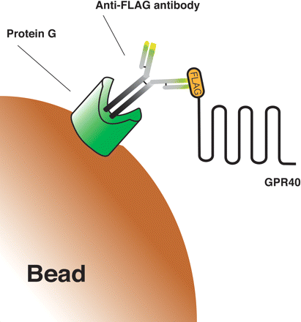
Immunoprecipitation assay
Tag
SOCS-2
(Sepharose or Agarose)

Slide 3
Immunoprecipitation assay
It is the technique of precipitating a protein “antigen” out of solution using “an antibody” that specifically binds to that particular protein “antigen” in a complex
This process can be used to isolate and concentrate a particular protein from a sample containing many thousands of different proteins
Immunoprecipitation requires that the antibody be coupled to a solid substrate at some point in the procedure. (Agarose solid-phase support )
The solution used in the form of a crude lysate of an animal tissue
Notes:
Immunoprecipitation of intact protein complexes (i.e. antigen along with any proteins or ligands that are bound to it)
This works when the proteins involved in the complex bind to each other tightly, making it possible to pull multiple members of the complex out of solution by latching onto one member with an antibody.

Slide 4
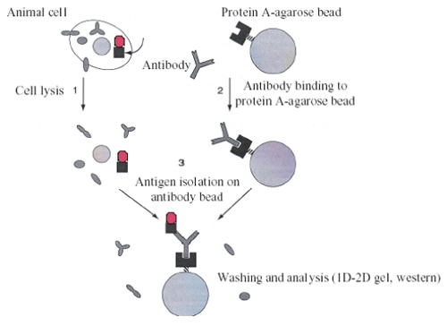
Direct Immunoprecipitation assay: Procedure
HEK 293T cell
SOCS2 complex
Tris-HCL/NaCl
Pre-clear with beads
Beads were washed in Equalizing buffer
Precipitate by Centrifugation
Notes:
Pre-clearing the lysate can help reduce non-specific binding of proteins to agarose or sepharose beads. Preclearing
with an irrelevant antibody or serum will remove proteins that bind immunoglobulins non-specifically. The
end result will be a lowering of background and an improved signal-to-noise ratio. However, if the final detection of
the protein is by immunoblotting, pre-clearing may not be necessary, unless a contaminating protein is interfering
with visualization of the protein of interest.

Slide 5
Immunoprecipitation assay
It is a powerful technique to analyze protein–protein interactions
(SOCS2, Elongin B, Elongin C, Cullin-5, & Ring-box)
(SOCS2 & Ubiquitin Ligase Complex)
Agarose beads are high porous & high potential binding capacity
The agarose particle are from 50 to 150 μm in size is available for binding to the antibodies
Notes:
Identifying the members of protein complexes may require several rounds of precipitation with different antibodies for a number of reasons:
A particular antibody often selects for a subpopulation of its target protein that has the epitope exposed, thus failing to identify any proteins in complexes that hide the epitope. This can be seen in that it is rarely possible to precipitate even half of a given protein from a sample with a single antibody, even when a large excess of antibody is used.
The first round of IP will often result in the identification of many new proteins that are putative members of the complex being studied. The researcher will then obtain antibodies that specifically target one of the newly identified proteins and repeat the entire immunoprecipitation experiment. This second round of precipitation may result in the recovery of additional new members of a complex that were not identified in the previous experiment. As successive rounds of targeting and immunoprecipitations take place, the number of identified proteins may continue to grow. The identified proteins may not ever exist in a single complex at a given time, but may instead represent a network of proteins interacting with one another at different times for different purposes.
Repeating the experiment by targeting different members of the protein complex allows the researcher to double-check the result. Each round of pull-downs should result in the recovery of both the original known protein as well as other previously identified members of the complex (and even new additional members). By repeating the immunoprecipitation in this way, the researcher verifies that each identified member of the protein complex was a valid identification. If a particular protein can only be recovered by targeting one of the known members but not by targeting other of the known members then that protein's status as a member of the complex may be subject to question.

Slide 6
Immunoprecipitation assay
The great difficulty in this assay is the generating monoclonal antibody that specifically targets a single known protein or protein complex
To get around this obstacle, many will engineer tags onto either the C- or N- terminal end of the protein of interest
The advantage here is that the same tag can be used several time and again on many different proteins and the researcher can use the same antibody each time
Examples of other tags in use:
Green Fluorescent Protein (GFP) tag
Glutathione-S-transferase (GST) tag
FLAG-tag
Notes:
While the use of a tag to enable pull-downs is convenient, it raises some concerns regarding biological relevance because the tag itself may either obscure native interactions or introduce new and unnatural interactions.

Slide 7
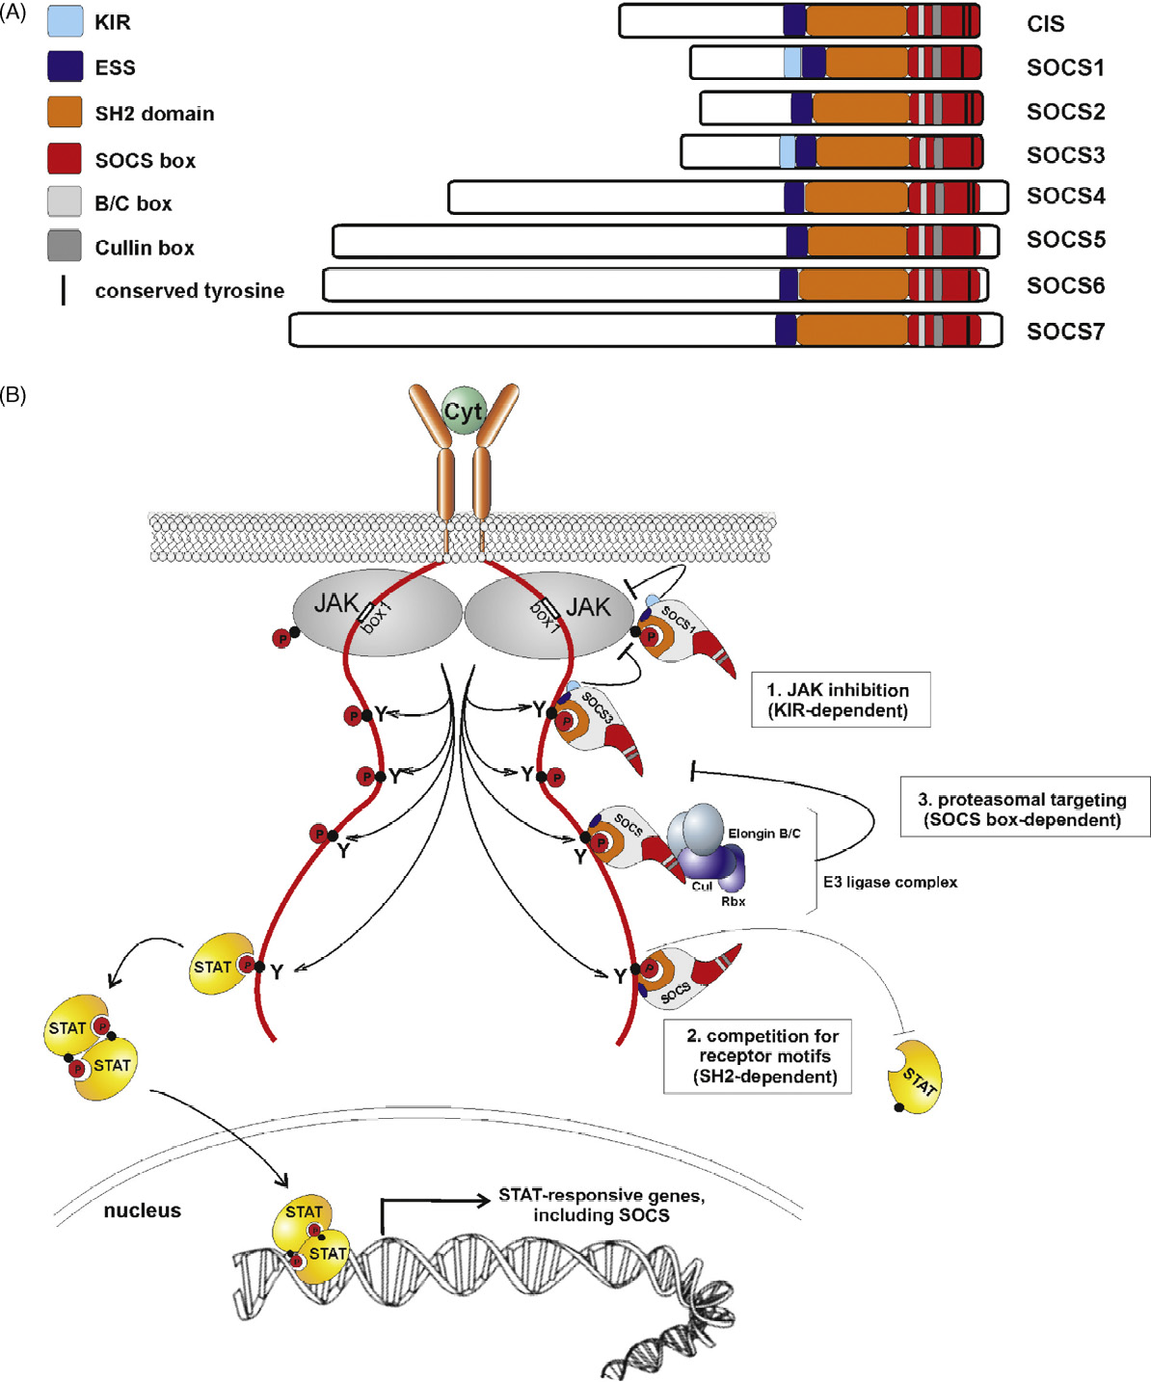
Central Dogma of the paper

Slide 8
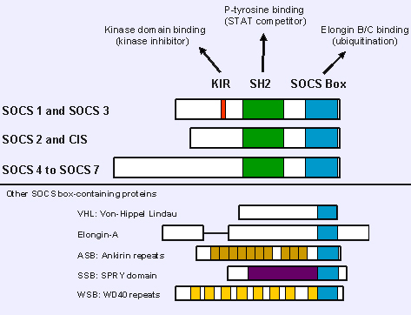
SOCS2 displays E3 ubiquitin ligase activity in vitro
SOCS2 is characterized by a SOCS-box at the C-terminal end of the protein, similarly to other ubiquitin ligases
They examine wither SOCS2 regulates cellular GHR levels through direct ubiquitination and in a proteasomally dependent manner
N-terminal: FLAG-Tag
Ubiquitin ligases
C-terminal

Slide 9
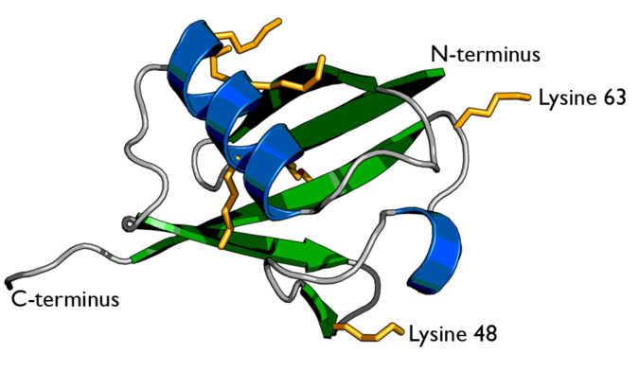
SOCS2 displays E3 ubiquitin ligase activity in vitro
Ubiquitin is a small regulatory protein that has been found in almost all tissues of eukaryotic organisms
The seven lysine side chains are shown in orange
Among other functions, it directs protein recycling

Slide 10
SOCS2 displays E3 ubiquitin ligase activity in vitro
Ubiquitin can be attached to proteins and label them for destruction.
The ubiquitin tag directs proteins to the proteasome, which is a large protein complex in the cell that degrades and recycles unneeded proteins.
Ubiquitin tags can also direct proteins to other locations in the cell, where they control other protein and cell mechanisms
This discovery won the Nobel Prize for chemistry in 2004

Slide 11
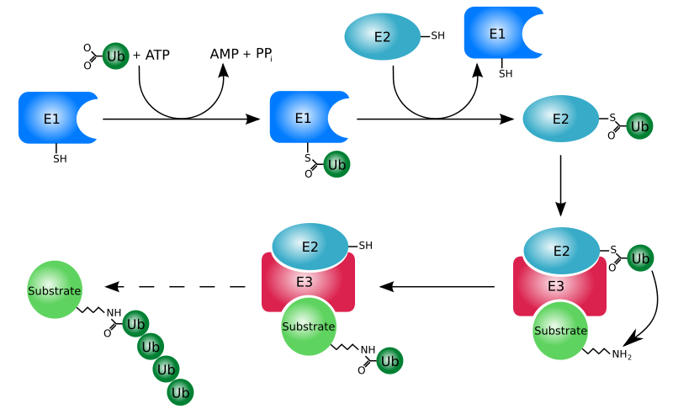
Ubiquitination: Principle
Cysteine Residue; active site
Glycine motif
ubiquitin-conjugating enzyme
ubiquitin-activating enzyme
Cysteine Residue; thioester linkage
Modified protein
Amide bond
Lysine-glycine
ubiquitin ligase
Notes:
Ubiquitination: is an enzymatic, post protein -translational modification process.
In which the carboxylic acid of the terminal glycine from the di-glycine motif in the activated ubiquitin forms an amide bond to the epsilon amine of the lysine in the modified protein.
The process of marking a protein with ubiquitin (ubiquitination) consists of a series of steps:
Activation of ubiquitin: Ubiquitin is activated by an E1 ubiquitin-activating enzyme in a process requiring ATP as an energy source.
The second step transfers ubiquitin to the E1 active site cysteine residue, with release of AMP.
This step results in a thioester linkage between the C-terminal carboxyl group of ubiquitin Glycine and the E1 cysteine sulfhydryl group.
Transfer of ubiquitin from E1 to the active site cysteine of a ubiquitin-conjugating enzyme E2 via a trans (thio) esterification reaction.
Mammalian genomes contain 30-40 UBCs.
The final step of the ubiquitylation cascade creates an iso-peptide bond between a lysine of the target protein and the C-terminal glycine of ubiquitin.
In general, this step requires the activity of one of the hundreds of E3 ubiquitin-protein ligases (often termed simply ubiquitin ligase).
E3 enzymes function as the substrate recognition modules of the system and are capable of interaction with both E2 and substrate.
In the ubiquitination cascade, E1 can bind with dozens of E2s, which can bind with hundreds of E3s in a hierarchical way. Other ubiquitin-like proteins (ULPs) are also modified via the E1–E2–E3 cascade

Slide 12
We wanted to investigate if the SOCS2 complex has activity as an ubiquitin ligase?

Slide 13
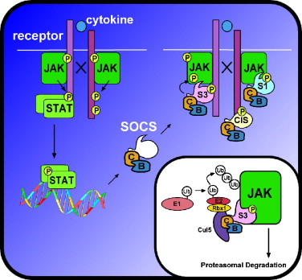
We wanted to investigate if the SOCS2 complex has activity as an ubiquitin ligase?
S2

Slide 15
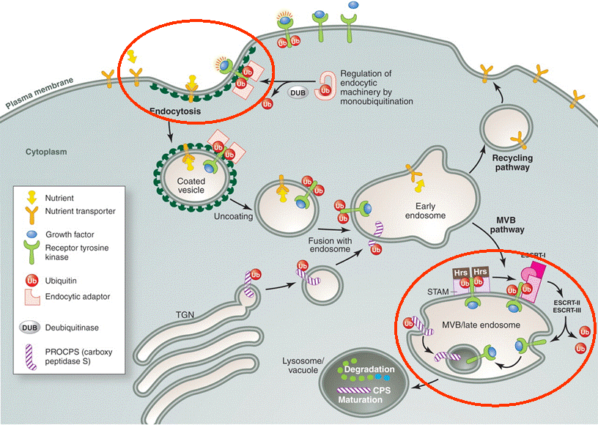

Slide 16
In vitro ubiquitination assay
Transfection: (As described by my colleague)
Immunoprecipitation:
Cells were lysed
FLAG-tagged proteins were immunoprecipitated
The immunoprecipitates were incubated at 30 °C with E1,E2, Ub and ATP regenerating system for 30 minutes
Western blot: (As described by my colleague)

Slide 17
SOCS2 exhibits E3 activity in the presence of E1, E2, Ubiquitin & ATP
High MW complex
An indication of ubiquitin ligase activity in the precipitates
Notes:
high molecular weight signals corresponding to HA-Ub covalently attached to high molecular weight protein
complexes are detected when all components of the system are present (Figure 2A, lane 2), an indication of ubiquitin ligase activity in the precipitates.

Slide 18
Mutant variants of SOCS2 & ubiquitin ligase activity
Notes:
Our results show that the SOCS2DSB mutant (Figure 2B, lane 4) exhibits clearly decreased ubiquitin ligase
activity as compared to the wild-type

Slide 19
Host cell treated with proteasome inhibitors (MG132 & Bortezomib)
-Ve
Mature is more
immature
Notes:
counteracted the reducing effect of SOCS2

Slide 20
Ubiquitin conjugates are more abundant when SOCS2,GHR, E1/E2 are present in vitro
SOCS2 & GHR are co-precipitated

Slide 21
